Slide 1
Omnidirectional robot
Programming in python with Raspberry pico RP2040

Slide 2
OBJECTIVE AND SCOPE OF THE PROJECT
Develop a python program to control a robot.
To develop functions:
front: Moves the robot forward in y axis.
back: Moves the robot backward in the y axis.
left: Turns the robot in the left direction.
rightShift: Slides the robot to right in the x axis.
diagonalRightFront: Moves diagonally in the x positive axis and y positive axis
diagonalLeftFront: Moves diagonally in the x negative axis and y positive axis
diagonalRightBack: Moves diagonally in the x positive axis and y negative axis
diagonalLeftBack: Moves diagonally in the x negative axis and y negative axis
right: Turns the robot in the right direction.
leftShift: Slides the robot to left in the x axis.
printInfo: Prints system name and embedded operating system name
changeSpeed: Updates the global speed variable ranging from 1-10 speeds
stop: Stop all the motors

Slide 3
Tools/Framework used
Table 3.1 Hardware used
Name | Quantity | Description
Raspberry pi pico RP2040 microcontroller | 1 | control the motors direction, speed
12v DC Geared Motors | 4 | 300 rpm
Dual tb6612fng | 2 | Motor driver for motor control
HM-10 BLE | 1 | Bluetooth 4.0 CC2541 module
Lipo Battery 12v | 1 | Power supply 2200 mah
Mecanum wheels | 4 | Omnidirectional wheels

Slide 4
Methodology
Table 4.1. Functions of the wheels
Functions | Wheel 1 | Wheel 2 | Wheel 3 | Wheel 4
front | ↑ | ↑ | ↑ | ↑
back | ↓ | ↓ | ↓ | ↓
leftShift | ↓ | ↑ | ↑ | ↓
rightShift | ↑ | ↓ | ↓ | ↑
diagonalLeftFront | ↑ | - | - | ↑
diagonalRightFront | - | ↑ | ↑ | -
diagonalLeftBack | - | ↓ | ↓ | -
diagonalRightBack | ↓ | - | - | ↓
leftTurn | ↓ | ↓ | ↑ | ↑
rightTurn | ↑ | ↑ | ↓ | ↓
stop | - | - | - | -

Slide 5
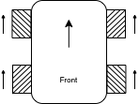
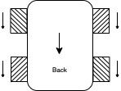
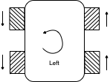
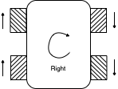
Front:
Wheel_1 <= High (Ain1<=High, Ain2<=Low)
Wheel_2 <= High (Bin1<=High, Bin2<=Low)
Wheel_3 <= High (Ain3<=High, Ain4<=Low)
Wheel_4 <= High (Bin4<=High, Bin4<=Low)
Back:
Wheel_1 <= Low (Ain1<=Low, Ain2<=High)
Wheel_2 <= Low (Bin1<=Low, Bin2<=High)
Wheel_3 <= Low (Ain3<=Low, Ain4<=High)
Wheel_4 <= Low (Bin3<=Low, Bin4<=High)
Left:
Wheel_1 <= Low (Ain1<=Low, Ain2<=High)
Wheel_2 <= Low (Bin1<=Low, Bin2<=High)
Wheel_3 <= High (Ain3<=High, Ain4<=Low)
Wheel_4 <= High (Bin3<=High, Bin4-<=Low)
Right:
Wheel_1 <= High (Ain1<=High, Ain2-<=Low)
Wheel_2 <= High (Bin1<=High, Bin2-<=Low)
Wheel_3 <= Low (Ain3<=Low, Ain4<=High)
Wheel_4 <= Low (Bin3-<=Low, Bin4<=High)

Slide 6
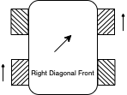
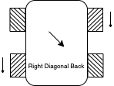
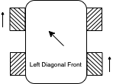
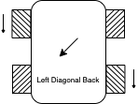
V. Right Diagonal Front
Wheel_1 <= Off
Wheel_2 <= High(Bin1<=High, Bin2<=Low)
Wheel_3 <= High (Ain3<=High, Ain4<=Low)
Wheel_4 <= Off
VI. Right Diagonal Back
Wheel_1 <= Off
Wheel_2 <= Low(Bin1<=Low, Bin2<=High)
Wheel_3 <= Low (Ain3<=Low, Ain4<=High)
Wheel_4 <= Off
VII. Left Diagonal Front
Wheel_1 <= High(Ain1<=High, Ain2<=Low)
Wheel_2 <= Off
Wheel_3 <= Off
Wheel_4 <= High(Bin3<=High, Bin4<=Low)
VIII. Left Diagonal Back
Wheel_1 <= Low(Ain1<=Low, Ain2<=High)
Wheel_2 <= Off
Wheel_3 <= Off
Wheel_4 <= Low(Bin3<=Low, Bin4<=High)

Slide 7
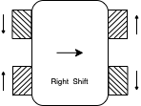
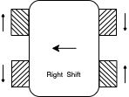
IX. Left Shift:
Wheel_1 <= Low (Ain1<=Low, Ain2<=High)
Wheel_2 <= High (Bin1<=High, Bin2<=Low)
Wheel_3 <= High (Ain3<=High, Ain4<=Low)
Wheel_4 <= Low (Bin3<=Low, Bin4<=High)
X. Right Shift:
Wheel_1 <= Low (Ain1<=Low, Ain2<=High)
Wheel_2 <= Low (Bin1<=Low, Bin2<=High)
Wheel_3 <= Low (Ain3<=Low, Ain4<=High)
Wheel_4 <= High (Bin3<=High, Bin4<=Low)

Slide 8
Algorithm
Step1: Start
Step2: Print system info
Step3: Initialise global variables and uart objects
Step4: while True
Step5: if uart.any()[2]
Step4: data <= uart.read()[2]
Step4: If (‘F’ in data): front()
Step5: elif (‘B’ in data): back()
Step6: elif (‘L’ in data): left()
Step7: elif (‘R’ in data): right()
Step8: elif (‘I’ in data): rightDiagonalFront()
Step9: elif (‘G’ in data): leftDiagonalFront()
Step10: elif (‘H’ in data): leftDiagonalBack()
Step11: elif (‘J’ in data): rightDiagonalBack()
Step12: elif (‘W’ in data): leftShift()
Step13: elif (‘U’ in data): rightShift()
Step14: elif (‘1’ in data): speed <= 10
Step15: elif (‘2’ in data): speed <= 20
Step16: e1if (‘3’ in data): speed <= 30
Step17: elif (‘4’ in data): speed <= 40
Step18: elif (‘5’ in data): speed <= 50
Step19: elif (‘6’ in data): speed <= 60
Step20: elif (‘7’ in data): speed <= 70
Step21: elif (‘8’ in data): speed <= 80
Step22: elif (‘9’ in data): speed <= 90
Step23: elif (‘10’ in data): speed <= 100
Step24: else(): stop()

Slide 9
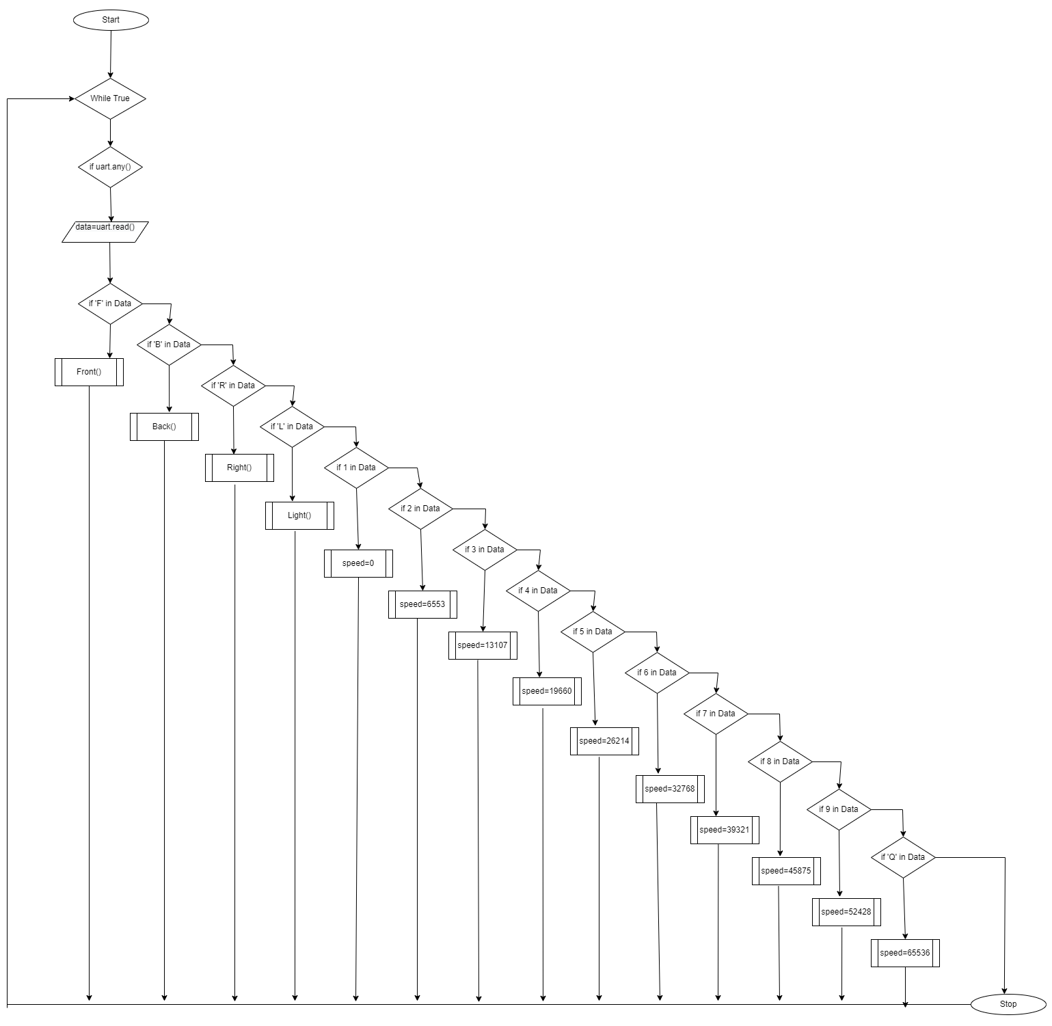
Flowchart

Slide 10
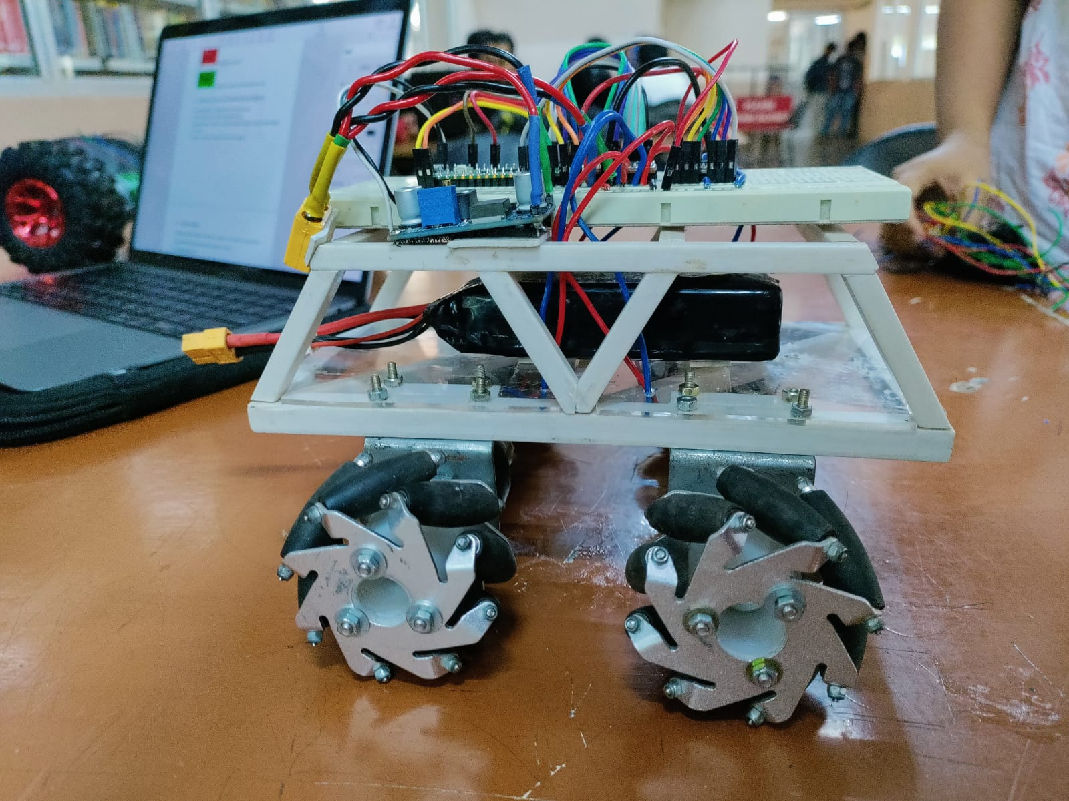
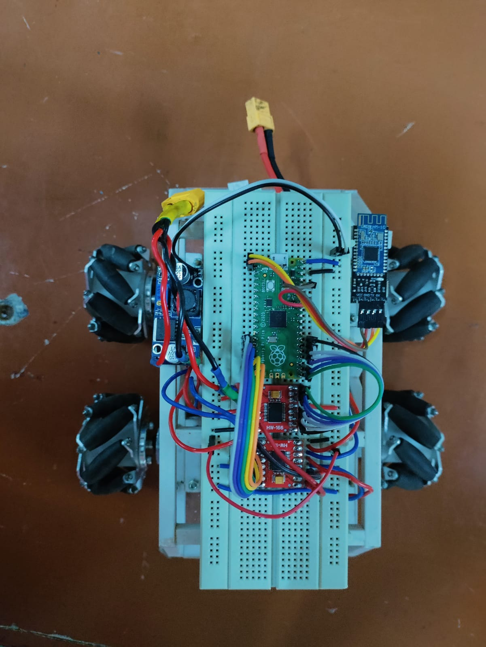
ScreenshotS
Side view of the bot
Top View of the bot

Slide 11
Thank you

